Slide 1
CIS 4517/5517:
Data Intensive and Cloud Computing
Cloud Security
Dr. Xubin He
Computer and Information Sciences
Temple University
Notes:
ECE6130: Computer Architecture, T.T.U

Slide 2
Today…
Part 1: Cloud security basics
Part 2: Information leakage in the cloud
Some slides of Part 1 are adopted/modified from Cristian Borcea, Bharat Bhargava, Anya Kim, YounSun Cho

Slide 3
Recent Cloud Security Data Breaches
In its Cyber Risk survey, the world's first Cyber Resilience startup UpGuard discovered that Accenture left at least four AWS S3 storage buckets unsecured in 2017.
In 2017, Verizon's third-party cohort, Nice Systems, erroneously exposed user PPI due to a faulty AWS S3 configuration.
In July 2021, IT solutions provider Kaseya suffered a massive attack on their unified remote monitoring and network perimeter security tool.
In May 2021, cybersecurity analytics giant Cognyte made a blunder leaving their database unsecured without authentication protocols.
Source: https://www.makeuseof.com/top-recent-cloud-security-breaches/, 2022

Slide 4
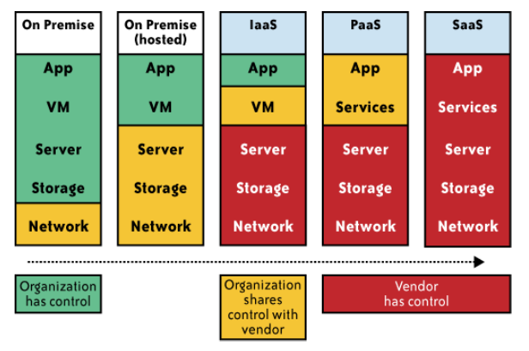
Impact of cloud computing on the governance structure of IT organizations
From [6] Cloud Security and Privacy by Mather and Kumaraswamy

Slide 5
Security and privacy vs sharing
The cloud acts as a big black box, nothing inside the cloud is visible to the clients.
Clients have no idea or control over what happens inside a cloud.
Even if the cloud provider is honest, it can have malicious system admins who can tamper with the VMs and violate confidentiality and integrity.
Clouds are still subject to traditional data confidentiality, integrity, availability, and privacy issues, plus some additional attacks

Slide 6
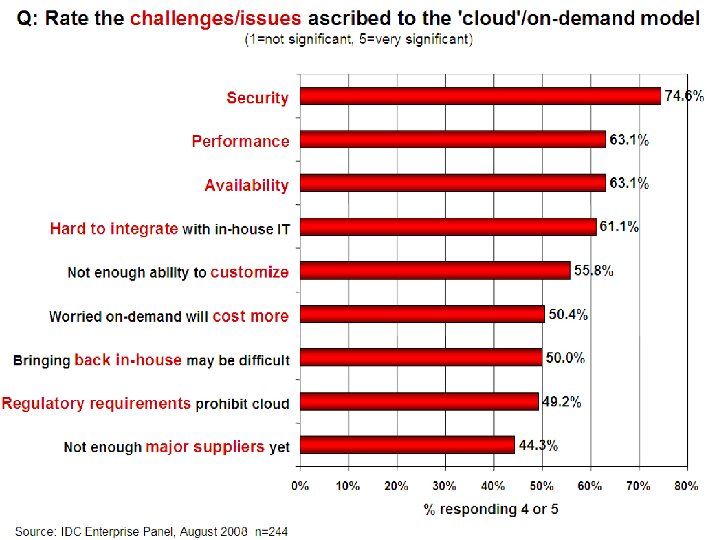
Companies are afraid to use clouds

Slide 7
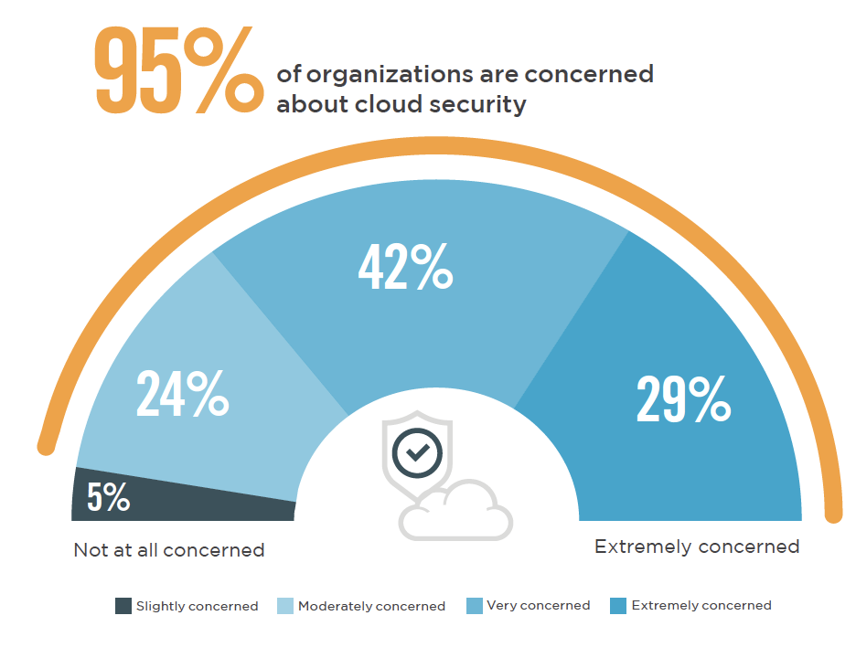
2021 AWS cloud security report
Source: https://fidelissecurity.com/resource/report/aws-cloud-security-report/

Slide 8
Causes of Problems Associated with Cloud Computing
Most security problems stem from:
  Loss of control
  Lack of trust (mechanisms)
  Multi-tenancy
These problems exist mainly in 3rd party management models
Notes:
Data mobility among cloud services, where to reside data?

Slide 9

Loss of Control in the Cloud
Consumer’s loss of control
  Data, applications, resources are located with providers
  User identity management is handled by the cloud
  User access control rules, security policies and enforcement are managed by the cloud providers
  Consumers rely on providers to ensure
    Data security and privacy
    Resource availability
    Monitoring and repairing of services/resources
Notes:
ECE6130: Computer Architecture, T.T.U

Slide 10
Lack of Trust in the Cloud
Trusting a third party requires taking risks
Lack of accountability and verifiability

Slide 11

Multi-tenancy Issues in the Cloud
Conflict between tenants’ opposing goals
  Tenants share a pool of resources and have opposing goals
How does multi-tenancy deal with conflict of interest?
  Can tenants get along together and ‘play nicely’ ?
  If they can’t, can we isolate them?
How to provide separation between tenants?
Cloud Computing brings new threats
  Multiple independent users share the same physical infrastructure
  Thus an attacker can legitimately be in the same physical machine as the target

Slide 12
Taxonomy of Fear
Confidentiality
  Fear of loss of control over data
    Will the sensitive data stored on a cloud remain confidential?
    Will cloud compromises leak confidential client data
  Will the cloud provider itself be honest and won’t peek into the data?
Integrity
  How do I know that the cloud provider is doing the computations correctly?
  How do I ensure that the cloud provider really stored my data without tampering with it?
Availability
  Will critical systems go down at the client, if the provider is attacked in a Denial of Service attack?
  What happens if cloud provider goes out of business?
  Would cloud scale well-enough?
From [5] www.cs.jhu.edu/~ragib/sp10/cs412
Notes:
ECE6130: Computer Architecture, T.T.U

Slide 13
Taxonomy of Fear (cont.)
Privacy issues raised via massive data mining
  Cloud now stores data from a lot of clients, and can run data mining algorithms to get large amounts of information on clients
Increased attack surface
  Entity outside the organization now stores and computes data, and so attackers can now target the communication link between cloud provider and client
  Cloud provider employees can be phished
Auditability and forensics (out of control of data)
  Difficult to audit data held outside organization in a cloud
  Forensics also made difficult since now clients don’t maintain data locally
Legal dilemma and transitive trust issues
  Who is responsible for complying with regulations?
  If cloud provider subcontracts to third party clouds, will the data still be secure?

Slide 14

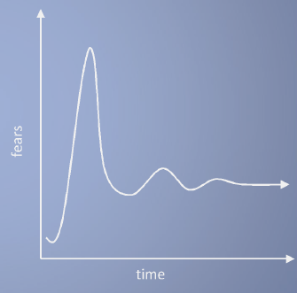
A Tough issue
Cloud Computing is a security nightmare and it can't be handled in traditional ways.
John Chambers
CISCO CEO
Security is one of the most difficult task to implement in cloud computing.
  Different forms of attacks in the application side and in the hardware components
Attacks with catastrophic effects only need one security flaw
(http://www.exforsys.com/tutorials/cloud-computing/cloud-computing-security.html)

Slide 15
Threat Model
A threat model helps in analyzing a security problem, design mitigation strategies, and evaluate solutions
Steps:
  Identify attackers, assets, threats and other components
  Rank the threats
  Choose mitigation strategies
  Build solutions based on the strategies
From [5] www.cs.jhu.edu/~ragib/sp10/cs412

Slide 16
Threat Model
Basic components
  Attacker modeling
    Choose what attacker to consider
      insider vs. outsider?
      single vs. collaborator?
    Attacker motivation and capabilities
  Attacker goals
  Vulnerabilities / threats

Slide 17

What is the issue?
The core issue here is the levels of trust
  Many cloud computing providers trust their customers
  Each customer is physically commingling its data with data from anybody else using the cloud while logically and virtually you have your own space
  The way that the cloud provider implements security is typically focused on the fact that those outside of their cloud are evil, and those inside are good.
But what if those inside are also evil?

Slide 18
Attacker Capability: Malicious Insiders
At clients
  Learn passwords/authentication information
  Gain control of the VMs
At cloud providers
  Log client communication
  Can read unencrypted data
  Can possibly peek into VMs, or make copies of VMs
  Can monitor network communication, application patterns
  Why?
    Gain information about client data
    Gain information on client behavior
    Sell the information or use itself

Slide 19
Attacker Capability: Outside attackers
What?
  Listen to network traffic (passive)
  Insert malicious traffic (active)
  Probe cloud structure (active)
  Launch DoS
Goal?
  Intrusion
  Network analysis
  Man in the middle

Slide 20
New Vulnerabilities & Attacks
Threats arise from other consumers
Due to the subtleties of how physical resources can be transparently shared between VMs
Such attacks are based on placement and extraction
A customer VM and its adversary can be assigned to the same physical server
Adversary can penetrate the VM and violate customer confidentiality

Slide 21
More on attacks…
Collaborative attacks
Mapping of internal cloud infrastructure
Identifying likely residence of a target VM
Instantiating new VMs until one gets co-resident with the target
Cross-VM side-channel attacks
Extract information from target VM on the same machine

Slide 22
Data Security
Several aspects of data security, including:
  Data-in-transit
    Confidentiality + integrity using secured protocol
    Confidentiality with non-secured protocol and encryption
  Data-at-rest
    Generally, not encrypted , since data is commingled with other users’ data
    Encryption if it is not associated with applications?
      But how about indexing and searching?
  Processing of data, including multitenancy
    For any application to process data
From [6] Cloud Security and Privacy by Mather and Kumaraswamy

Slide 23
Data Security
  Data lineage
    Knowing when and where the data was located w/i cloud is important for audit/compliance purposes
    e.g., Amazon AWS
      Store <d1, t1, ex1.s3.amazonaws.com>
      Process <d2, t2, ec2.compute2.amazonaws.com>
      Restore <d3, t3, ex2.s3.amazonaws.com>
  Data provenance
    Computational accuracy (as well as data integrity)
    Data deduplication and replication

Slide 24
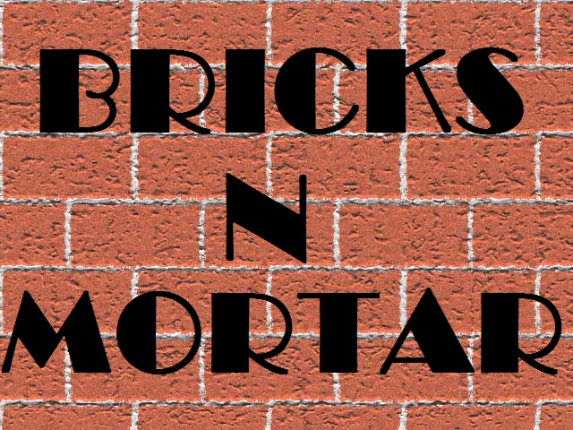
Possible solutions
In theory, minimizing any of the issues would help.
  Loss of Control
    Take back control
      Data and apps may still need to be on the cloud
      But can they be managed in some way by the consumer?
  Lack of trust
    Increase trust (mechanisms)
      Technology
      Policy, regulation
      Contracts (incentives)
  Multi-tenancy
    Private cloud (PC)
      Takes away the reasons to use a cloud in the first place
    VPC (Virtual Private Cloud): its still not a separate system
    Strong separation

Slide 25
Minimize Lack of Trust: Policy Language
Consumers have specific security needs but don’t have a say-so in how they are handled
  Currently consumers cannot dictate their requirements to the provider (SLAs are one-sided)
Standard language to convey one’s policies and expectations
  Agreed upon and upheld by both parties
  Standard language for representing SLAs
Create policy language with the following characteristics:
  Machine-understandable (or at least processable),
  Easy to combine/merge and compare

Slide 26

Minimize Lack of Trust: Certification
Certification
  Some form of reputable, independent, comparable assessment and description of security features and assurance
    Sarbanes-Oxley, DIACAP, DISTCAP, etc
Risk assessment
  Performed by certified third parties
  Provides consumers with additional assurance

Slide 27
Minimize Loss of Control: Monitoring
Cloud consumers need situational awareness for critical applications
  When underlying components fail, what is the effect of the failure to the mission logic
  What recovery measures can be taken
    by provider and consumer
Requires an application-specific run-time monitoring and management tool for the consumers
  The cloud consumer and cloud provider have different views of the system
  Enable both the provider and tenants to monitor the components in the cloud that are under their control

Slide 28
Minimize Loss of Control: Monitoring
  Provide mechanisms that enable the provider to act on attacks he can handle.
    infrastructure remapping
      create new or move existing fault domains
    shutting down offending components or targets
      and assisting tenants with porting if necessary
    Repairs
  Provide mechanisms that enable the consumer to act on attacks that he can handle
    application-level monitoring
    RAdAC (Risk-adaptable Access Control)
    VM porting with remote attestation of target physical host
    Provide ability to move the user’s application to another cloud

Slide 29
Minimize Loss of Control: Utilize Different Clouds
The concept of ‘Don’t put all your eggs in one basket’
  Consumer may use services from different clouds through an intra-cloud or multi-cloud architecture
  A multi-cloud or intra-cloud architecture in which consumers
    Spread the risk
    Increase redundancy (per-task or per-application)
    Increase chance of mission completion for critical applications
  Possible issues to consider:
    Policy incompatibility (combined, what is the overarching policy?)
    Data dependency between clouds
    Differing data semantics across clouds
    Knowing when to utilize the redundancy feature
      monitoring technology
    Is it worth to spread your sensitive data across multiple clouds?
      Redundancy could increase risk of exposure

Slide 30
Minimize Loss of Control:
Access Control
Many possible layers of access control
  E.g. access to the cloud, access to servers, access to services, access to databases (direct and queries via web services), access to VMs, and access to objects within a VM
  Depending on the deployment model used, some of these will be controlled by the provider and others by the consumers
Regardless of deployment model, provider needs to manage the user authentication and access control procedures (to the cloud)
  Federated Identity Management: enabling the consumer-side to manage its users, but access control management burden still lies with the provider
  Requires user to place a large amount of trust on the provider in terms of security, management, and maintenance of access control policies.
    This can be burdensome when numerous users from different organizations with different access control policies, are involved

Slide 31
Minimize Loss of Control:
Access Control
Consumer-managed access control
  Consumer retains decision-making process to retain some control, requiring less trust of the provider
  Requires the client and provider to have a pre-existing trust relationship, as well as a pre-negotiated standard way of describing resources, users, and access decisions between the cloud provider and consumer.
    It also needs to be able to guarantee that the provider will uphold the consumer-side’s access decisions.
  Should be at least as secure as the traditional access control model.

Slide 32

Minimize Loss of Control:
Access Control
Cloud Provider in Domain A
Cloud Consumer in Domain B
Identity
Provider
1. Authn request
IDP
Policy
Enforcement
Point
(intercepts all
resource
access requests
from all client
domains)
3. Resource request (XACML Request) + SAML assertion
2. SAML Assertion
.
.
.
4. Redirect to domain of resource owner
Policy
Decision
Point
for cloud
resource
on Domain A
5. Retrieve policy
for specified resource
resources
ACM
(XACML
policies)
7. Send signed and encrypted ticket
6. Determine whether user can access
specified resource
7. Create ticket for grant/deny
8. Decrypt and verify signature
9. Retrieve capability from ticket
10. Grant or deny access based on capability
Security Assertion Markup Language
eXtensible Access Control Markup Language

Slide 33
Minimize Loss of Control: IDM
Issues in Cloud Computing
Cloud introduces several issues to IDM
  Users have multiple accounts associated with multiple service providers.
  Present IDMs require a trusted third party and do not work on an untrusted host.
  Lack of trust
    Use of Trusted Third Party is not an option
    Cloud hosts are untrusted
  Loss of control
    Collusion between Cloud Services
      Sharing sensitive identity information between services can lead to undesirable mapping of the identities to the user.
IDM in Cloud needs to be user-centric

Slide 34



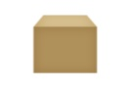

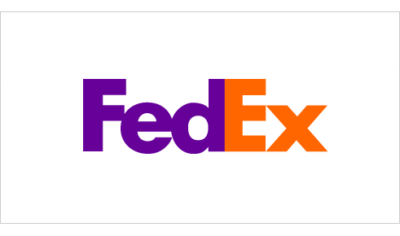
Minimize Loss of Control:
ID management in the cloud
User on Amazon Cloud
Name
E-mail
Password
Billing Address
Shipping Address
Credit Card
Name
Billing Address
Credit Card
Name
E-mail
Password
Billing Address
Shipping Address
Credit Card
Name
E-mail
Shipping Address
Name
E-mail
Shipping Address

Slide 35
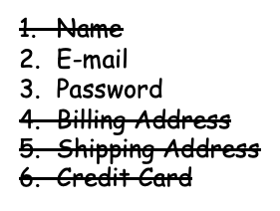
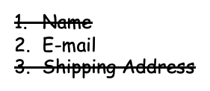
Minimize Loss of Control:
ID management in the cloud
User on Amazon Cloud
Name
Billing Address
Credit Card
Name
E-mail
Password
Billing Address
Shipping Address
Credit Card
Name
E-Mail
Shipping Address

Slide 36
Minimize Multi-tenancy
Can’t really force the provider to accept less tenants
  Can try to increase isolation between tenants
    Strong isolation techniques (VPC to some degree)
    QoS requirements need to be met
    Policy specification
  Can try to increase trust in the tenants
    Who’s the insider, where’s the security boundary? Who can I trust?
    Use SLAs to enforce trusted behavior

Slide 37
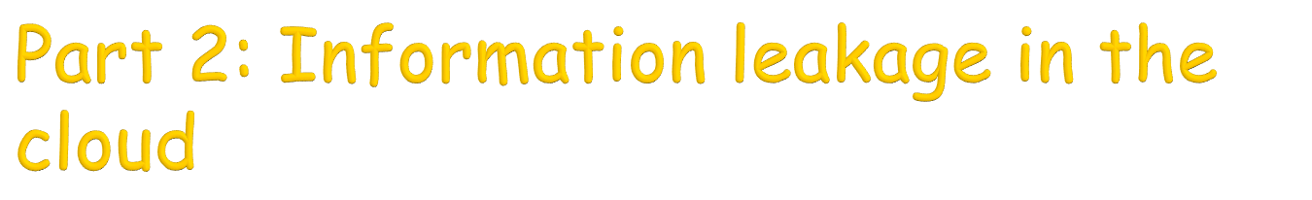
Thomas Ristenpart, Eran Tromer,Hovav Shacham,Stefan Savage “Hey, You, Get Off of My Cloud: Exploring Information Leakage in Third-Party Compute Clouds”, ACM CCS’2009.

Slide 38
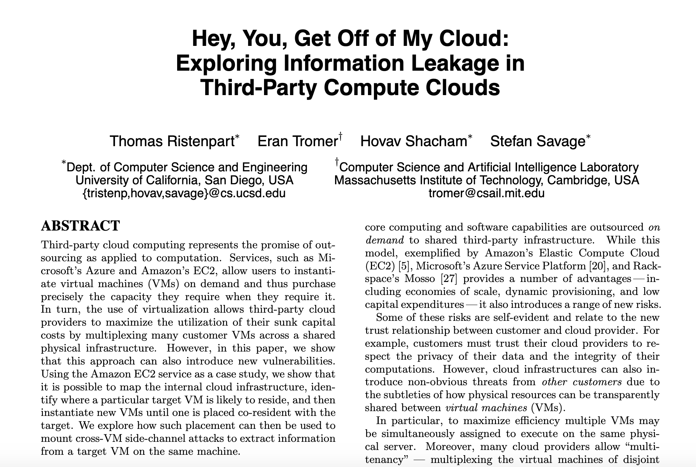

Slide 39
Motivation
Multitenancy
  Multiplexing the virtual machines of disjoint customers upon the same physical hardware
  Customer’s VM could be assigned to the same physical server as their adversary
New threat: adversary might penetrate the isolation between VMs
  E.g., via a vulnerability that allows an “escape” to the hypervisor or via side-channels between VMs (leakage due to sharing - e.g., the CPU’s data caches)

Slide 40
Threat Model
Consider the provider and its infrastructure to be trusted
Do not consider attacks that rely upon subverting a cloud’s administrative functions
  Insider abuse
  Vulnerabilities in the cloud management systems
Adversaries are malicious parties not affiliated with the provider
  Malicious parties can run and control many instances in the cloud
  Attacker’s instances might even run on the same physical hardware as potential victims
Victims are users running cloud services requiring confidentiality

Slide 41
Questions
Can one determine where in the cloud infrastructure an instance is located?
Can one easily determine if two instances are co-resident on the same physical machine?
Can an adversary launch instances that will be co-resident with other user’s instances?
Can an adversary exploit cross-VM information leakage once co-resident?

Slide 42
Virtualization in EC2 - Xen
Run different OSs as guest operating systems over a version of the Xen hypervisor
Privileged VM, Domain 0 (Dom0) manages
  Guest images
  Physical resource provisioning
  Access control
Dom0 is configured to route packets for its guest images and reports itself as a hop in traceroute

Slide 43
Cloud Cartography
‘Map’ EC2 services
  Understand where potential targets are located in the cloud
  Understand instance creation parameters needed to establish co-residence of an adversarial instance
Speed up adversarial strategies for placing a malicious VM on the same machine as a target
Datasets
  Public EC2-based web servers determined using external probes and translating responsive public IPs to private IPs
    Translation done using DNS queries within the cloud
  IP addresses assigned to newly created EC2 instances

Slide 44
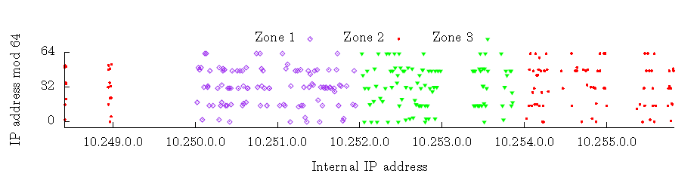
Internal IP Address Assignment (1)
Each zone assigns IP addresses from disjoint portions of address space
  All IPs from a /16 prefix are from the same availability zone
A plot of the internal IP addresses assigned to instances launched during the initial mapping experiment using Account A.

Slide 45
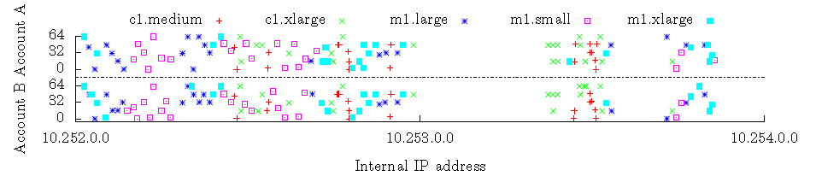
Internal IP Address Assignment (2)
A plot of the internal IP addresses of instances launched in Zone 3 by Account A and, 39 hours later, by Account B. Fifty-five of the Account B IPs were repeats of those assigned to instances for Account A.

Slide 46
Preventing Cloud Cartography
Make internal IP addresses not statically associated to availability zone and instance type
  Changing this would likely make administration tasks more challenging and costly for providers
Prevent public to internal IP translation
  One could use ping timing measurements or traceroutes to help “triangulate” on a victim

Slide 47
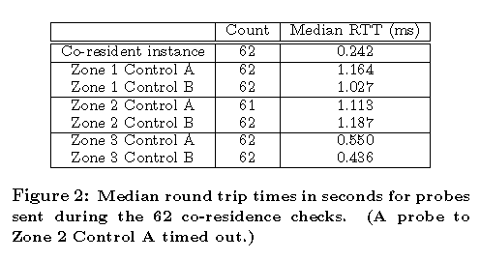
Determining Co-Residence
Compare internal IP addresses of the two instances
If they are numerically close:
  Traceroute to an open port on the target
  If there is a single hop (i.e., Dom0 IP address), then the instances are co-resident

Slide 48
Load-Based Co-Residence Detection
Consider target instances for which computational load can be induced
  Example - an instance running a (public) web server
Attacker instance compares load samples taken when externally inducing load on the target versus when not
  Can thus check for co-residence

Slide 49
Placement in EC2
Try to arrange for an instance to be placed on the same physical machine as one of the victims
Strategies include:
  Brute Force
    Launch many instances over a relatively long period of time
    Achieves reasonable success rate for relatively large target sets
  Target recently-launched instances
    Takes advantage of the tendency for EC2 to assign new instances to the same small set of machines

Slide 50
Brute-force Placement
Attacker enumerates a set of potential target victims
Infers targets belonging to a particular availability zone instance type using the map
Repeatedly runs probe instances in the target zone and of the target type
Probe instance checks if it is co-resident with any of the targets
If not, the instance is quickly terminated
Results: of 1686 target victims, achieved 141 co-residents (8.4% coverage)

Slide 51
Placement: Experimental Observations
An account never had two instances simultaneously running on the same physical machine
  Running n instances in parallel under a single account results in placement on n separate machines
No more than eight m1.small instances simultaneously co-resident
While a machine is full, there is no chance of being assigned to it
Sequential placement locality
  Two instances which run sequentially, often assigned to same machine
Parallel placement locality
  Two instances which run from distinct accounts at roughly the same time, often assigned to same machine

Slide 52
Abusing Placement Locality
Launch instances soon after a particular target victim is launched
Attacker monitors a server’s state (e.g., via network probing)
Waits until the instance disappears
If it re-appears as a new instance, engage in instance flooding
  Running as many instances in parallel as possible
Also try to actively trigger new victim instances by misusing auto scaling systems

Slide 53
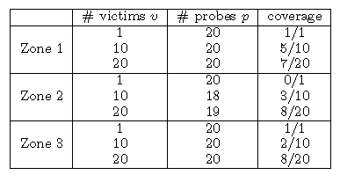
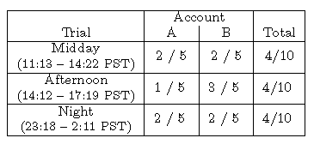
Placement in EC2
Launch p probes 5 minutes after the launch of v victims
  Coverage = number of co-residencies between victims and probes
40% Co-residence

Slide 54
Placement with Increased Time Lag
40 victim instances placed on 36 unique machines
Every hour, a set of 20 attack instances launched in the same zone
Co-residence checks performed
Attack instances terminated immediately after completion of the checks
Co-residence achieved with 24 of 36 machines
  Probes were placed on all 4 machines with two victims
  Success rate of each attack round stays essentially the same

Slide 55
Cross-VM Information Leakage
Malicious instance can utilize side channels to learn information about co-resident instances
Time-shared caches allow an attacker to measure when other instances are experiencing computational load
  Co-residence detection
  Detection of the rate of web traffic a co-resident site receives

Slide 56
Cache-based Load Measurement
Probing instance first allocates a contiguous buffer B of b bytes
  b should be large enough that a significant portion of the cache is filled by B
  Let s be the cache line size, in bytes
Probing instance performs the following steps to generate each load sample:
  Prime: Read B at s-byte offsets in order to ensure it is cached
  Trigger: Busy-loop until the CPU’s cycle counter jumps by a large value
    VM was preempted by the Xen scheduler, hopefully in favor of the victim VM
  Probe: Measure the time it takes to again read B at s-byte offsets
    Time is higher if the victim VM was active (evicted some cache)
Notes:
ECE6130: Computer Architecture, T.T.U

Slide 57
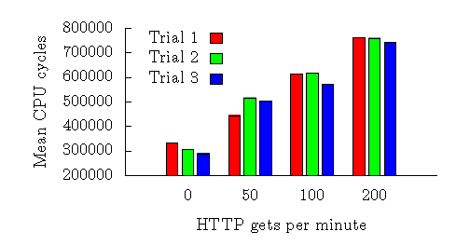
Estimating Traffic Rates
Load measurement can help estimate the number of visitors to a co-resident web server
  This information may not be public & leaking it could be damaging
Results show clear correlation between cache-based load measurements and traffic rates

Slide 58
Inhibiting Side-Channel Attacks
Blinding techniques to minimize the information that can be leaked
  Cache wiping, random delay insertion, adjusting each machine’s perception of time
Most countermeasures suffer from following drawbacks
  Impractical (e.g., high overhead)
  Application-specific
  Insufficient for fully mitigating the risk
  All possible side-channels have to be anticipated and disabled
Best Defenses
  Deny the ability to perform co-residence checks
  Deny the ability to exploit instance placement

Slide 59
Conclusion
Cloud computing:
  Resources are ubiquitous, scalable, highly virtualized
  Contains all the traditional threats, as well as new ones
In developing solutions to cloud computing security issues, it may be helpful to identify the problems and approaches in terms of
  Loss of control
  Lack of trust
  Multi-tenancy problems

Slide 60
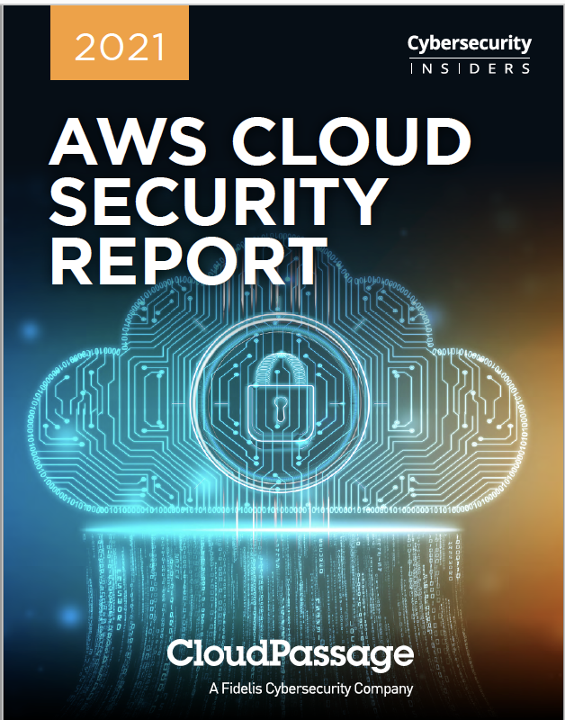
Source: https://fidelissecurity.com/resource/report/aws-cloud-security-report/

Slide 61
References
Bhargava et al, Security issues in cloud computing, https://www.cs.purdue.edu/homes/bb/cs590
NIST (Authors: P. Mell and T. Grance), "The NIST Definition of Cloud Computing (ver. 15)," National Institute of Standards and Technology, Information Technology Laboratory (October 7 2009).
J. McDermott, (2009) "Security Requirements for Virtualization in Cloud Computing," presented at the ACSAC Cloud Security Workshop, Honolulu, Hawaii, USA, 2009.
C. Borcea, Cloud computing, https://web.njit.edu/~borcea/cs643/
Security and Privacy in Cloud Computing, Dept. of CS at Johns Hopkins University. www.cs.jhu.edu/~ragib/sp10/cs412
Cloud Security and Privacy: An Enterprise Perspective on Risks and Compliance by Tim Mather and Subra Kumaraswamy
Cloud Standards Customer Council, Security for Cloud Computing Ten Steps to Ensure Success Version 2.0, 2015
Thomas Ristenpart, Eran Tromer,Hovav Shacham,Stefan Savage “Hey, You, Get Off of My Cloud: Exploring Information Leakage in Third-Party Compute Clouds”, ACM CCS’2009.
2021 AWS cloud security report, https://fidelissecurity.com/resource/report/aws-cloud-security-report/

Slide 62
Next
Cloud storage
Quiz 5: Lectures 11 and 12 (finding similar items and cloud security)

